Slide 1
Sofia, September 30, 2015
Data Collection Strategies for Rietveld Refinement Using Laboratory X-ray Diffraction Data
J. Rodríguez-Carvajal
Diffraction Group
Institut Laue-Langevin

Slide 2
The ideal powder diffraction pattern
In order to refine a crystal structure with X-ray powder diffraction data the data collection should optimize the conditions for getting the intensities as close as possible to those calculated for the correct structure:
1: Billions of homogeneous and densely packed randomly oriented grains (grains below 10 μm)
2: “Infinitely” thick sample with a smooth and a flat surface for Bragg-Brentano geometry
3: Effective μR < 1.5 for Debye-Scherrer geometry

Slide 3
Problems: particle statistics
If there are not enough crystallites contributing to the diffraction pattern, then the observed peak intensities will not be as expected
Poor particle statistics may be due to:
1: a too large average grain size
2: a too small irradiated volume (very small X-ray
beam or not enough amount of material in the
sample)
3: a too tightly collimated X-ray beam (e.g.
synchrotron radiation needs rotating samples in
order to increase the particle statistics)

Slide 4
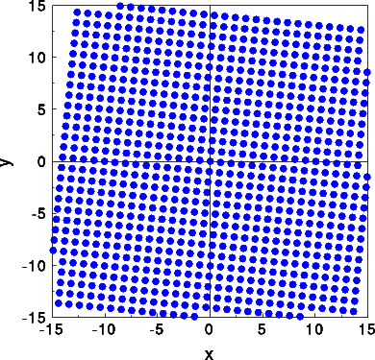
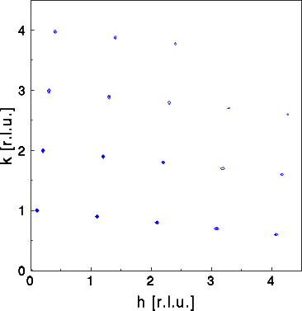
Powder Diffraction
Real space
Reciprocal space
Single Crystal

Slide 5
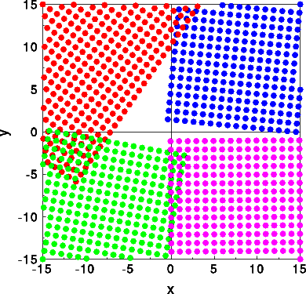
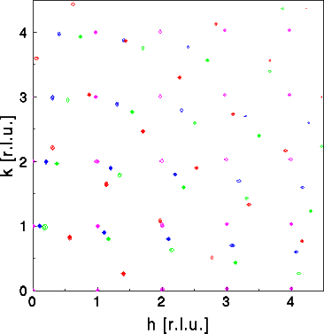
Powder Diffraction
Real space
Reciprocal space
Four Single Crystals

Slide 6
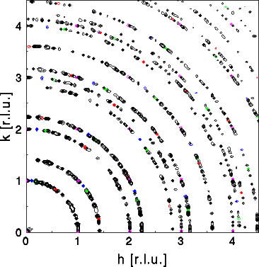
Powder Diffraction
Reciprocal space
Forty Single Crystals

Slide 7
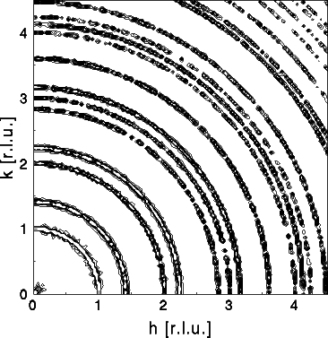
Powder Diffraction
Reciprocal space
Two hundred Single Crystals

Slide 8
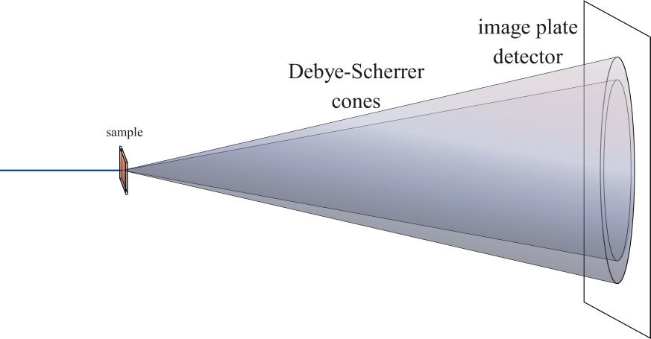
Powder Diffraction
In three dimensions the reciprocal space corresponding to billions of crystals is a set of concentric spherical shells. The intersection of these shells with the Ewald Sphere gives rise to powder diffraction as a set of Debye-Sherrer cones

Slide 9
Problems: particle statistics
The number of crystallites contributing to a single reflection is a small fraction of the total number of crystallites in the sample.
To get a similar number of crystallites for all reflections one has to diminish the size of the grains, increase the divergence of the beam and the acceptance of the detector (receiving slits) (beware! This degrades the resolution)
A strong absorbing sample produces a small penetration depth and a weak number of contributing crystallites.

Slide 10
Problems: preferred orientation
It is very difficult to avoid preferred orientation when we have plate or needle like shapes of crystallites
Top-loading and pressing the powder into a holder, can cause problems with preferred orientation
Metallic ingots, sheets or wires lead almost always to preferred orientation due to the manufacturing process.
Preferred orientation causes a systematic error in peak intensities that may hamper the refinement of a crystal structure.
Full texture of a sample can be determined using X-ray diffraction in a special equipment allowing the orientation of the sample

Slide 11
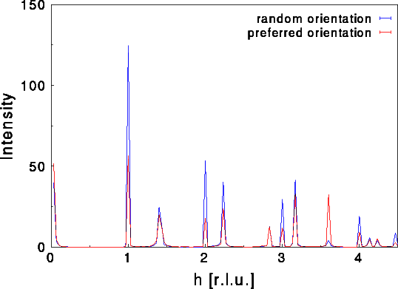
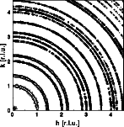
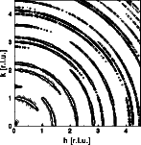
Powder Diffraction: preferred orientation
Preferred orientation is the main limitation factor for exploiting the intensities of X-ray powder diffraction. In order to use powders for structure determination and refinement one has to avoid preferred orientation

Slide 12
Preparing a powder sample
Avoid preferred orientation!
Diminish the grain sizes and avoid top-loading with pressuring the powder
Rotate the sample during the data collection
In Bragg-Brentano geometry this allows a better treatment using the March-Dollase model
In Debye-Sherrer geometry the possible preferred orientation and particle statistics is strongly diminished

Slide 13
Preparing a powder sample
Avoid large crystallite sizes!
Large crystallite sizes and non-random crystallite orientations (preferred orientation) lead to peak intensity variations: the measured diffraction pattern will never agree with that expected from an ideal powder

Slide 14
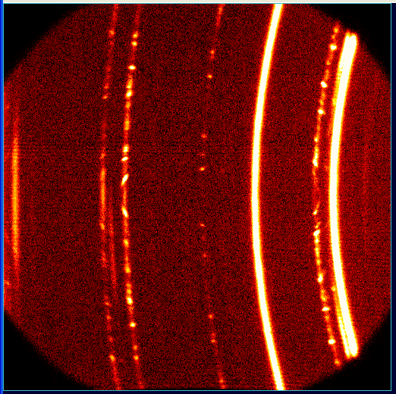
Spotty Debye-Scherrer rings
Mixture of fine and coarse grains in a sample

Slide 15
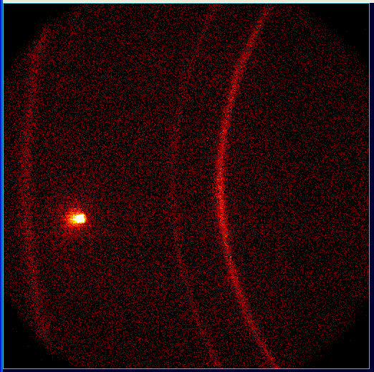
Spotty Debye-Scherrer rings
Polycrystalline sample on a single crystal substrate

Slide 16
Preparing a powder sample
If you have spotty data from a sample with large grain sizes it is impossible to refine the crystal structure or to do quantitative phase analysis.
However:
You can determine unit cell lattice parameters
and
In some cases you can determine crystallite size and microstrain

Slide 17
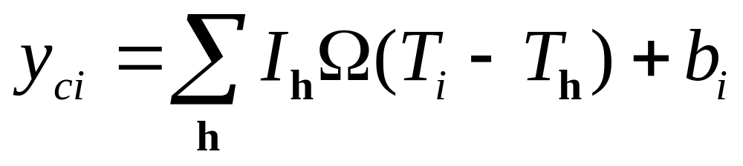
The knowledge of your diffractometer is crucial for the success of Rietveld refinement
The model to calculate a powder diffraction pattern is:

Slide 18
The knowledge of your diffractometer is crucial for the success of Rietveld refinement
The contribution from the instrument can be calculated using the fundamental parameters approach by multiple convolution of the different aberrations due to the optics of the diffractometer and contributions from the sample (this need a nearly perfectly aligned instrument)
We will use a simplified method assuming nearly Voigtian profiles convoluted with axial divergence effects for the instrument contribution

Slide 19
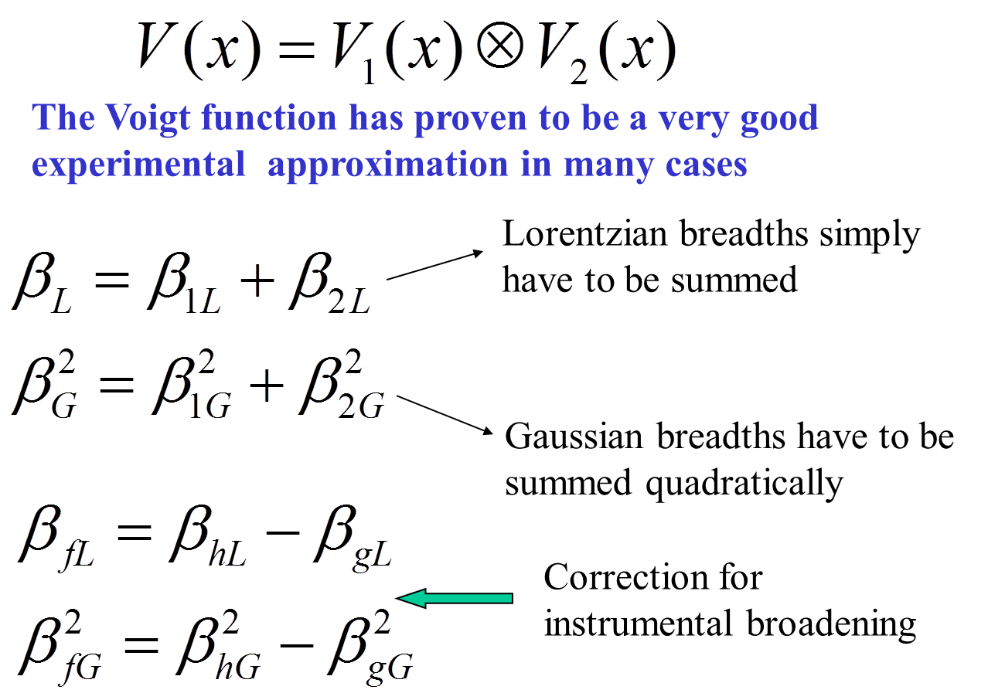
The Voigt approximation for both the sample and the instrument contribution

Slide 20
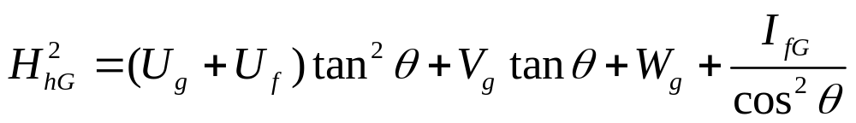
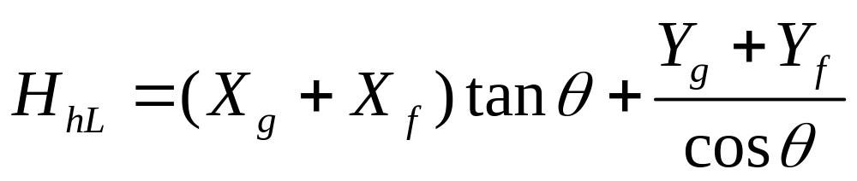
Profile Parameters (Voigt Approx.)
Simple cases: isotropic broadening
Parameters controlling the Full-Width at half maximum
U, V, W, I_{G}, X, Y

Slide 21
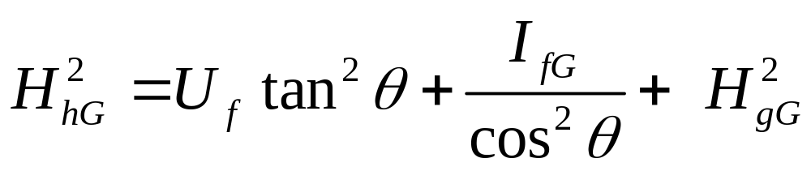
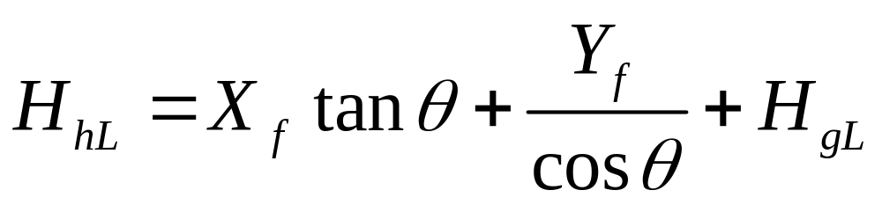
Instrumental and sample contribution to the broadening
The Gaussian and Lorentzian contributions of the instrument must be determined experimentally with a size/strain-free sample
Sample
Instrument

Slide 22
The knowledge of your diffractometer is crucial for the success of Rietveld refinement
If you have a Bragg-Brentano diffractometer take the diffraction pattern of a standard sample not having size or strain broadening (e.g. LaB₆ from NIST). The diffraction pattern should be taken in exactly the same conditions as your problem sample.
You can prepare your own standard if you are able to prepare a sample with similar absorption coefficient as your problem sample and very good crystallinity.
For capillary samples Na₂Ca₃Al₂F₁₄ (NAC or Nacalf, from Le Mans, France) is appropriate.

Slide 23
Procedure for working with micro-structural effects in FullProf
↓ Characterise the IRF of the diffractometer using calibrating
samples
↓ Use WinPLOTR for creating an INSTRUMENTAL
RESOLUTION FILE (Fit individual peaks through the pattern)
or just a refine with FullProf your standard sample
↓ Use FullProf with IRF putting to ZERO all FWHM
parameters
↓ Select a model for microstructure and refine only the
parameters related to the sample.
↓ The program generates a microstructural file and
other files for plot

Slide 24
The format of the file containing the Instrumental Resolution Function
The instrumental resolution function file may content keywords that change some variables in the input PCR file if they are used. Now it is possible to read an IRF file for other profiles than NPROF=7.
The most simple format for the case RES /= 4,8 is the following:
Line 1: General title
Next lines containing ! are comments
Lines containing one of the keywords:
JOBT, WAVE, PROF, ASYM (order does not matter)
One or two lines containing the variables (see manual):
UINS, VINS, WINS, XINS, YINS, ZINS
In case of two lines the second corresponds to instrumental parameters for the second wavelength.

Slide 25
The format of the file containing the Instrumental Resolution Function
The keywords in the IRF are accompanied by values as follows:
1: JOBT job (character variable)
with job = 'neuc' or 'NEUC' for jobtyp = 3
job = 'neut' or 'NEUT' for jobtyp = 1
job = 'tof' or 'TOF' for jobtyp =-1
job = 'tofc' or 'TOFC' for jobtyp =-3
job = 'xr' or 'XR' for jobtyp = 0
job = 'xrc' or 'XRC' for jobtyp = 2
2: WAVE lambda1, lambda2, ratio (three real values)
3: PROF nprofile, shape1, shape2, shape3 (1 integer and 3 real numbers)
4: ASYM S_L, S_D (two real numbers)

Slide 26
The knowledge of your diffractometer is crucial for the success of Rietveld refinement
If you have a Bragg-Brentano diffractometer take the diffraction pattern of a standard sample not having size or strain broadening (e.g. LaB₆ from NIST). The diffraction pattern should be taken in exactly the same conditions as your problem sample.
You can prepare your own standard if you are able to prepare a sample with similar absorption coefficient as your problem sample and very good crystallinity.
For capillary samples Na₂Ca₃Al₂F₁₄ (NAC or Nacalf, from Le Mans, France) is appropriate.

