Slide 1
Sofia, October 1, 2015
Understanding defective materials using powder diffraction (FullProf).
The case of layered materials (FAULTS).
J. Rodríguez-Carvajal
Diffraction Group
Institut Laue-Langevin

Slide 2
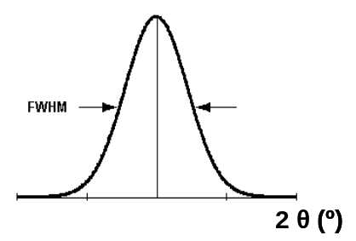
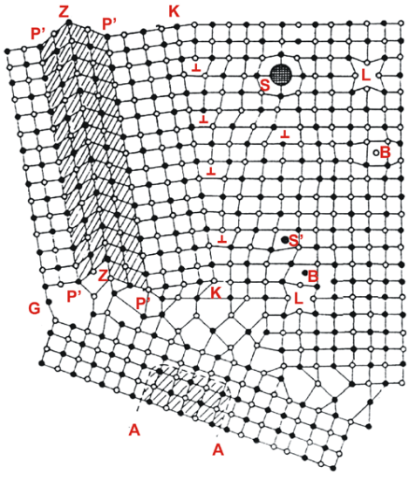
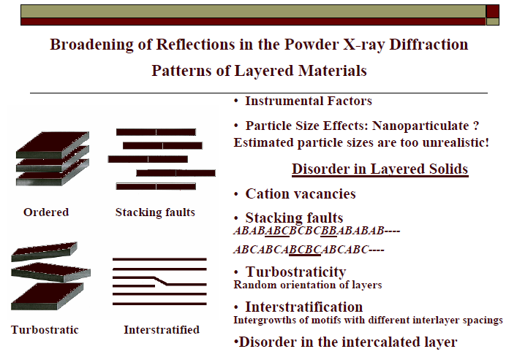
Microstructure: defects in crystals
Instrumental broadening
FWHM
Finite crystallite size
FWHM ∝ cos⁻¹(θ)
2θ (°)
size < 1 µm
Can be included in
Rietveld refinement
Lattice microstrains
A antiphase domain
B interstitial atom
G, K grain boundary
L vacancy
S substitutional impurity
S’ interstitial impurity
P, Z stacking faults
┴ dislocations
FWHM ∝ tan(θ)
fluctuations in cell parameters
Extended defects / Disorder
- Antiphase boundaries
- Vacancies / Atomic disorder
- Stacking Faults
Simulation with DIFFaX
- Turbostraticity
- Interstratification
Now: simulation and refinement
with FAULTS

Slide 3
Outline of the talk
Diffraction patterns of real crystals
Conventional microstructure analysis
Examples using FullProf
Diffraction by layered materials.
The program FAULTS

Slide 4
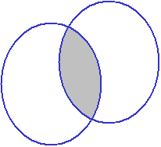
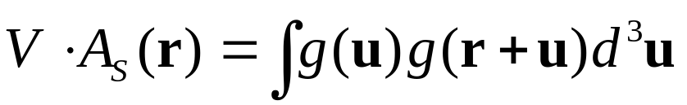
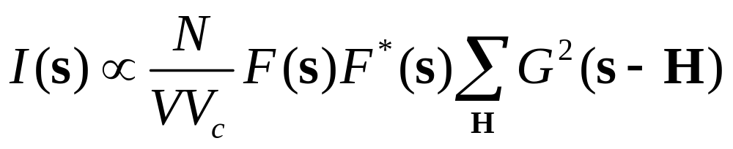
Scattered Intensity of a Finite Crystal
Shape function: g(r) is defined as g(r)=1 for r inside the crystal, and g(r)=0 for r outside ⇒ G(s)=FT{g(r)}.
G²(s )=FT{g(r)⊗g(-r)} is Fourier transform of the auto-correlation function:
r
A_{S}(r) is the fraction of the total volume shared in common between the object and its "ghost" displaced by the vector r. A_{S}(0)=1 and decreases as r increases. G²(s)=V FT{A_{S}(r)}

Slide 5
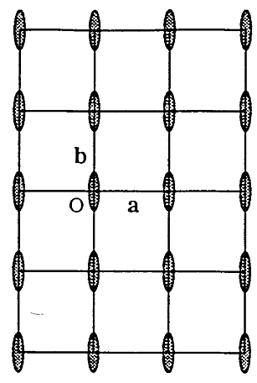
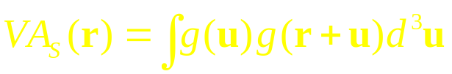
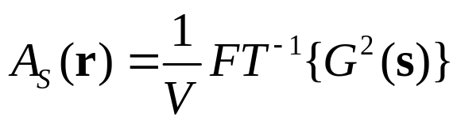
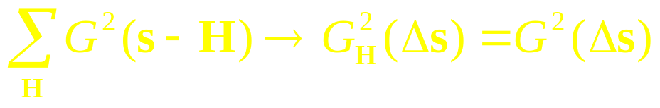
Size effects in reciprocal space
r
G determines the shape of the peak profile and it is the same for all reciprocal nodes
Width of peak increases in 2θ space as (cosθ)⁻¹. Except for spheres, the width depends on the direction in reciprocal space

Slide 6
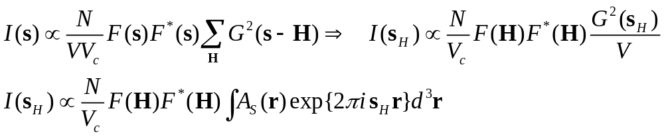
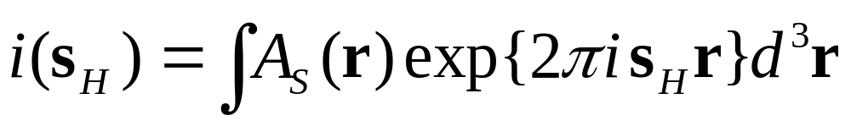
Size effects in reciprocal space
Normalised profile of a single crystal spot in reciprocal space: Fourier transform of the size function A_{S}(r)
In powder diffraction we obtain a similar equation restricted to columns perpendicular to diffracting planes

Slide 7
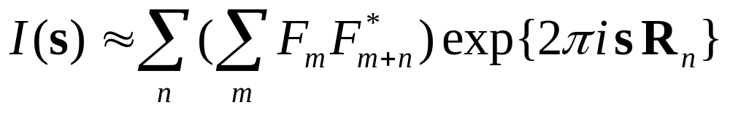
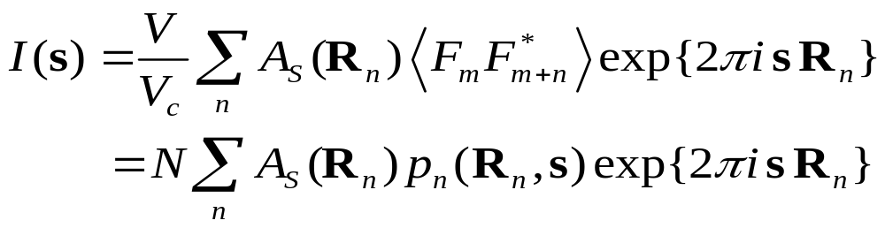
Scattered Intensity of a Real Crystal
Defects: average lattice + structure factor depending on unit cell
F_{m} = F_{m}(s) is the structure factor of the cell m.
p_{n}(R_{n},s)=⟨F_{m} F*_{m+n}⟩ is independent of m, but depends on s.
The number of terms in the inner sum is given by VA_{S}(R_{n})/V_{c} and the equation can be transformed to:

Slide 8
Real Crystals: diffuse scattering
Average structure factor: F= ⟨F⟩ =1/N ∑_{m}F_{m}
local fluctuation of the structure factor: φ_{n}=F-F_{n}
p_{n}=F²+⟨φ_{m}φ*_{m+n}⟩ = F²+Φ_{n},
The intensity formula can be transformed to:
I(s) = I_{Bragg} + I_{Diffuse} =
N F²∑_{n}A_{S}(R_{n}) exp {2πi s R_{n}} + N ∑_{n}A_{S}(R_{n}) Φ_{n}exp{2πi sR_{n}}=
N F²/(VV_{c}) ∑ _{H}G²(s-H) + N ∑_{n} Φ_{n} exp{2πi s R_{n}}
In the last expression, we have made the approximation A_{S}(R_{n})=1 because Φ_{n} decreases with n much faster than A_{S}(R_{n}).

Slide 9
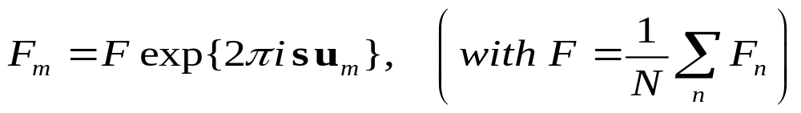
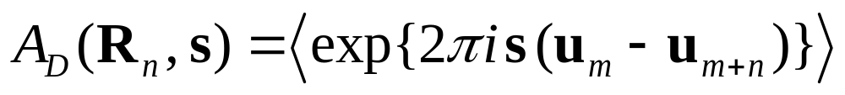
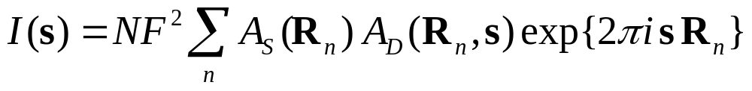
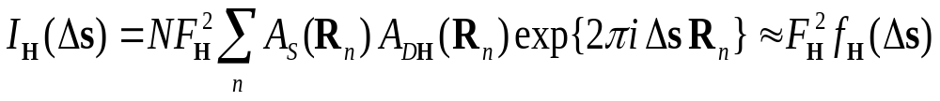
Strained Crystals
A crystal is said to be “strained” if the structure factor of the cell m can be written in the form:
Defining the quantity:

Slide 10
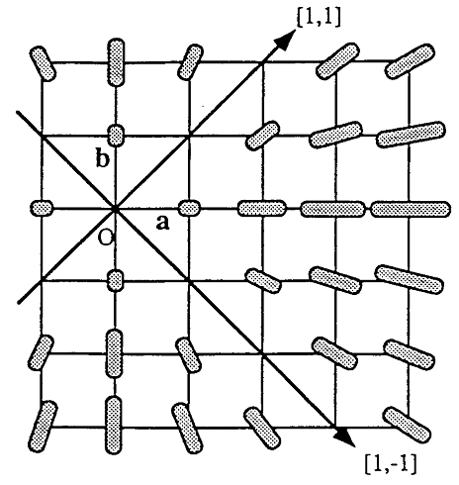
Strain effects in reciprocal space
The interpretation of the peak shape in the case of strains is not so straightforward as that of size because there are many possible physical origins for strain broadening: dislocations, interstitials, vacancies, compositional fluctuations, etc.
The important point is that the peak shape and width depend on both the particular reflection and the direction in reciprocal space.
Width of peaks increases in 2θ space as tanθ in most of the cases.

Slide 11
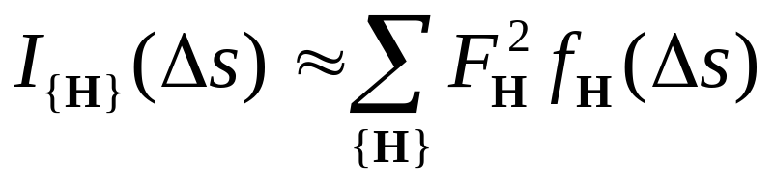
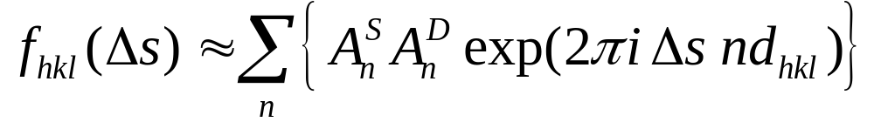
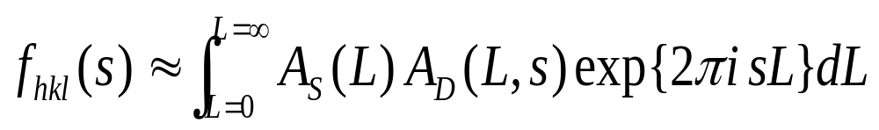
Powder peak profiles
For a powder (after spherical averaging), the total profile is a superposition of the profiles of the set of equivalent nodes and the distribution function for size and strain effects:
Usual notation in literature:
Microstructure Analysis from Diffraction
Edited by R. L. Snyder, H. J. Bunge, and J. Fiala, International Union of Crystallography, 1999

Slide 12
Outline of the talk
Diffraction patterns of real crystals
Conventional microstructure analysis
Examples using FullProf
Diffraction by layered materials.
The program FAULTS

Slide 13
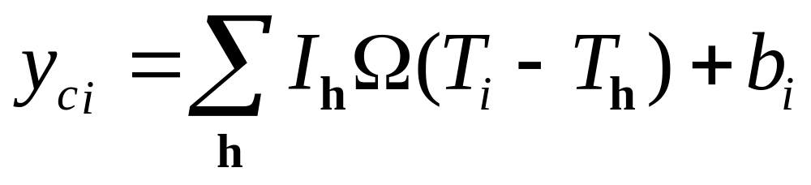
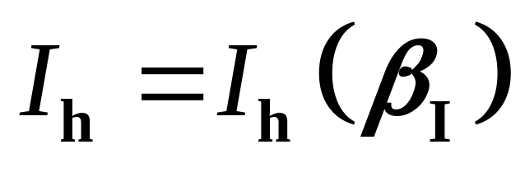
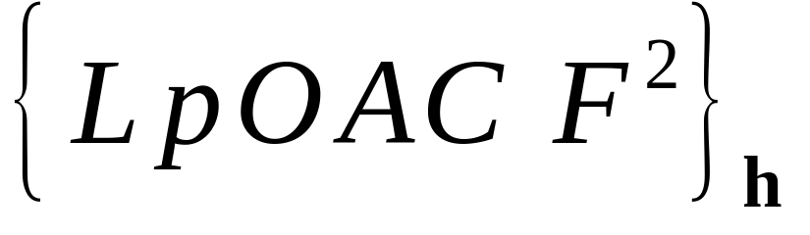
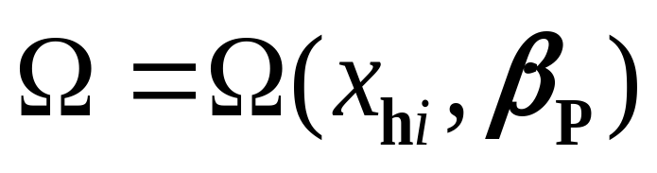
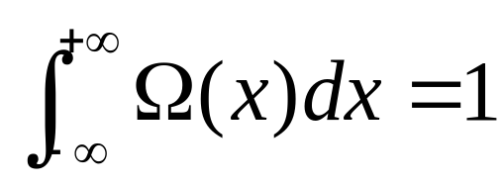
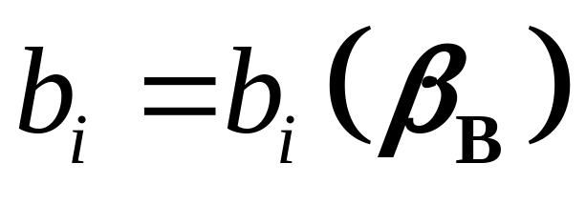
Calculation of the full profile of a powder diffraction pattern
Contains structural information:
atom positions, magnetic moments, etc
Contains micro-structural information:
instr. resolution, defects, crystallite size, ...
Background: noise, diffuse scattering, ...

Slide 14
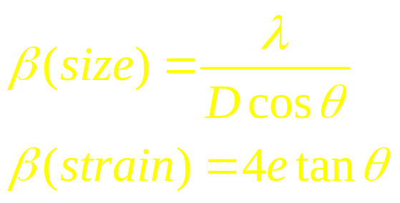
Simplified methods for treating the intrinsic profile as implemented in FullProf
The method of Warren-Averbach, based in the Fourier series representing the intrinsic profile of a powder diffraction peak, has drawbacks when overlap is strong. Moreover, not enough statistics make the de-convolution method extremely unstable
Integral breadth methods, combined with an analytical approximation for f, g and Ω, are, by far, much more simple and robust: strain and size parameters are volume averaged quantities

Slide 15

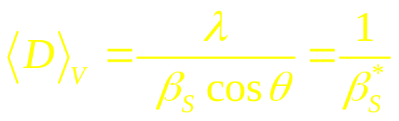
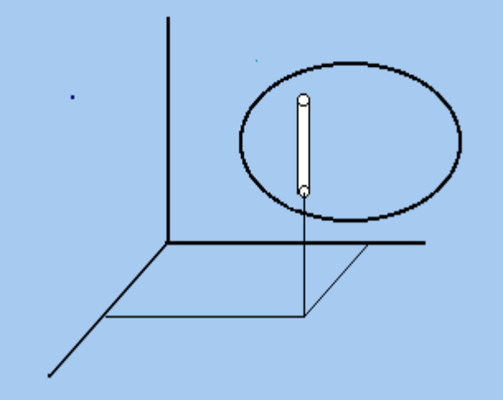
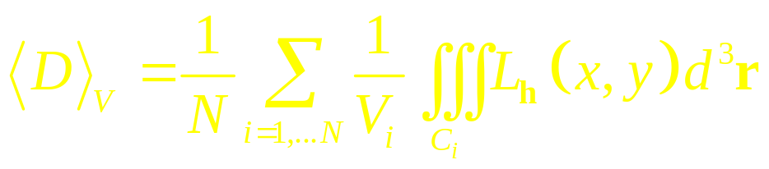
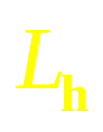
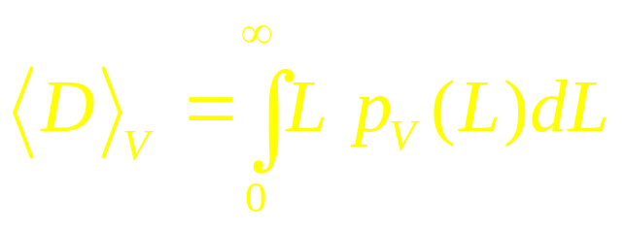
Broadening due to size effects
The intrinsic profile of a particular reflection due to size effect has an integral breadth , the Scherrer formula:
gives the volume-averaged apparent size of the crystallites in the direction normal to the scattering planes. This apparent size has a perfectly defined physical interpretation:
in terms of the normalized column-length
distribution p_{V}(L):
h
Ω
y
x

Slide 16
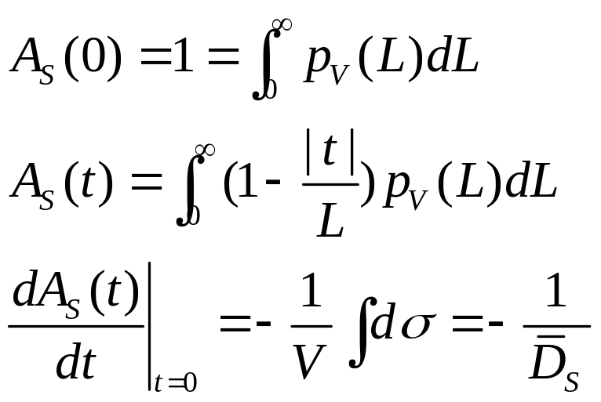
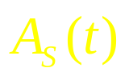
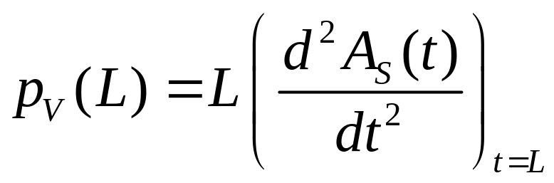
Size effects in reciprocal space: powder case
Surface Averaged column length D_{S}: height of a cylinder of section equal to the projection of the grain perpendicular to planes (hkl) having the same volume as the grain
Normalised column-length distribution
t
t₀=D_{S}

Slide 17
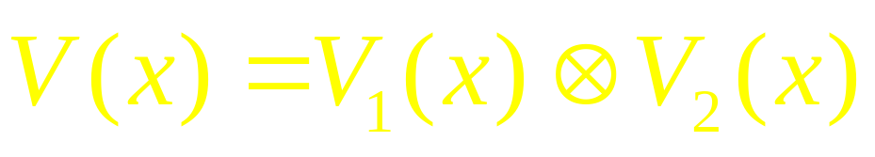
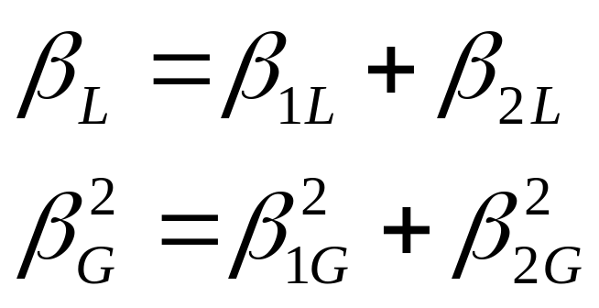
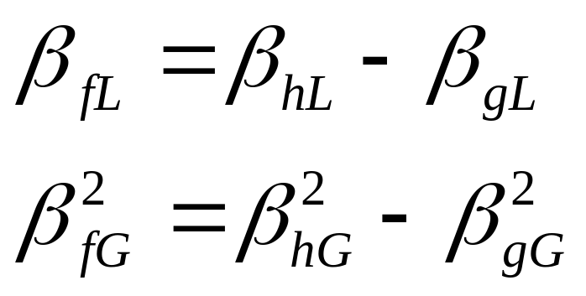
The Voigt Function
The Voigt function has proven to be a very good experimental approximation in many cases (I. Langford)
Lorentzian breadths simply have to be summed
Gaussian breadths have to be summed quadratically
Correction for instrumental broadening
(‘Double Voigt’, D. Balzar)

Slide 18

Column lengths distributions when using Voigt functions for approximating the line profile
Fourier size coefficients corresponding to the Voigt function
Normalised distribution of column lengths

Slide 19
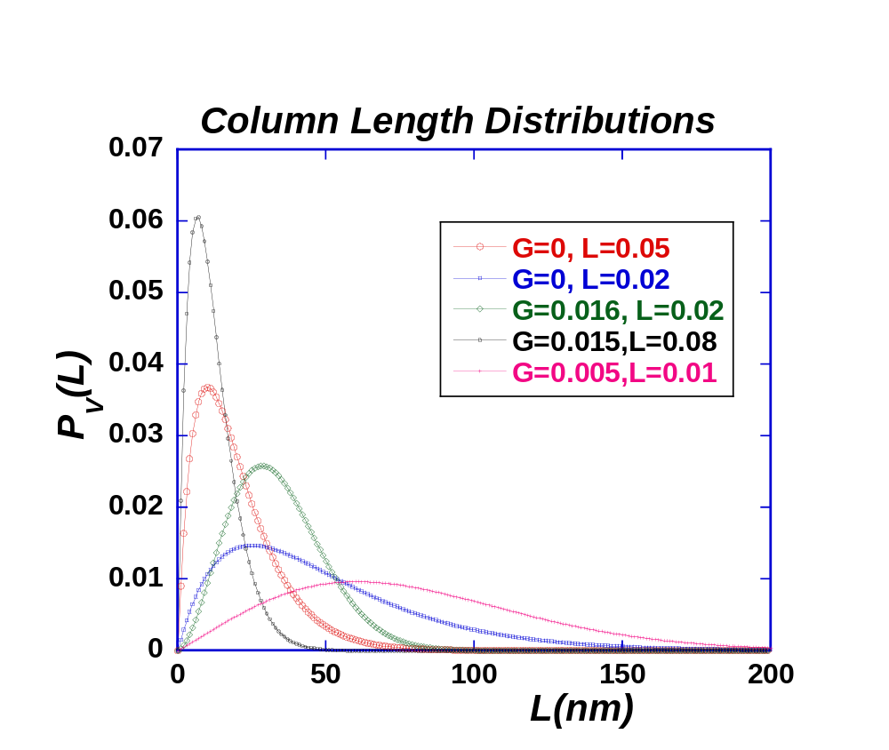
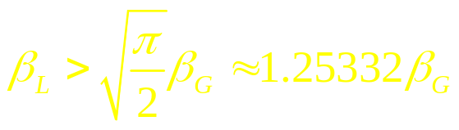
Column lengths distributions when using Voigt functions for approximating the line profile
Size distributions corresponding to Voigt profiles are quite flexible and are positive for all lengths provided that:

Slide 20
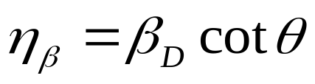
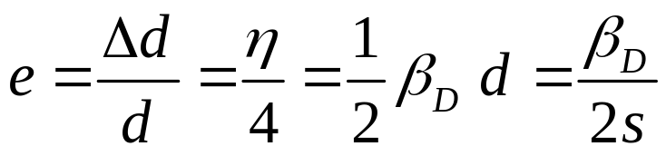

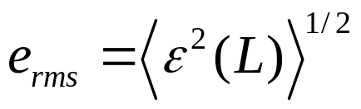
Definitions of strain in microstructural analysis
The apparent strain was defined by Wilson as the quantity:
The so-called maximum strain is related to the apparent strain by the relation:
Local average strain: between two cells separated a distance L along a column perpendicular to (hkl) planes
Root mean square strain:
For a Gaussian distribution e ≈ 5/4 e_{rms}
See chapter 7 of Microstructure Analysis from Diffraction by Davos Balzar

Slide 21
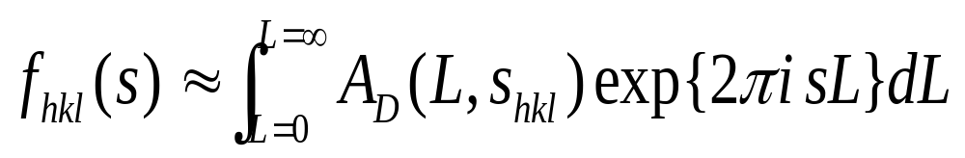
Definitions of strain in microstructural analysis
Local average strain: between two cells separated a distance L along a column perpendicular to (hkl) planes

Slide 22
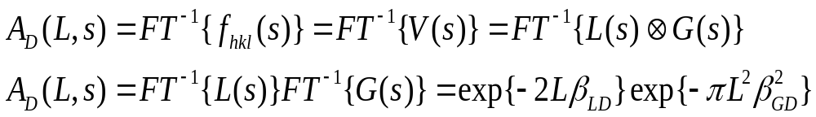
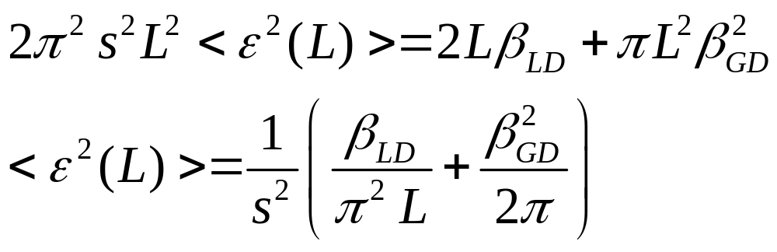
Definitions of strain in microstructural analysis
Local average strain: between two cells separated a distance L along a column perpendicular to (hkl) planes

Slide 23
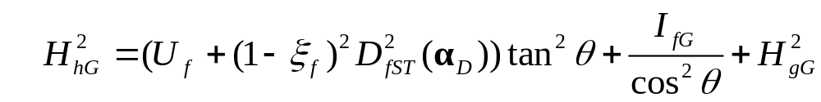
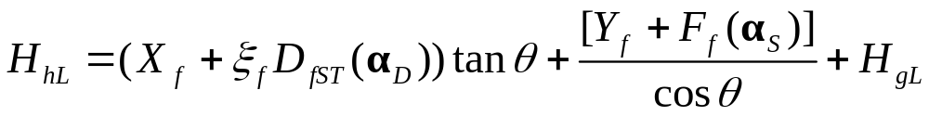
Simplified methods for treating the intrinsic profile as implemented in FullProf
General 2θ dependence of the instrumental broadening (determined by a standard sample)
The Gaussian and Lorentzian components of the instrumental Voigt function are interpolated between empirically determined values.
If needed, axial divergence is convoluted numerically with the resulting profile.

Slide 24

Anisotropic strains
Phenomenological model: strains considered as fluctuations
and correlation between metric parameters
J. Rodríguez-Carvajal, M.T. Fernández-Díaz and J.L. Martínez
J. Phys. Cond. Matt. 3, 3215 (1991)
The metric parameters α_{i} (direct, reciprocal or any combination) are considered as stochastic variables with a Gaussian distribution characterized by :
the mean ⟨α_{i}⟩ and
the variance-covariance matrix C_{ij}

Slide 25




The mean and the variance of the function M_{hkl} are given by :
C_{ij} contains 21 parameters,
15 independent
If the metric parameters are taken as the coefficients of the
quadratic form:
{α_{i}}={A,B,C,D,E,F}
P. W. Stephens,
J. Appl. Cryst. 32, 281 (1999)

Slide 26

Example of microstrain generated after a series of phase transitions

Slide 27



Different models to simulate the average shape of crystallites
Ellipsoidal shapes of crystallites .
Arbitrary shapes of crystallites can be simulated using spherical harmonics.
Volume averaged shape of crystallites is obtained from the refined parameters

Slide 28
How to work with FullProf when microstructural effect are important
➢ Selected profile function:
NPROF=7: TCH pseudo-Voigt function convoluted with axial
divergence
➢ Reference sample data analysis ➔ Instrumental Resolution Function
(create an IRF file)
➢ Broadened pattern analysis: IRF is fixed through RES parameter
and read in the FILERES file
➢ Use FullProf with IRF (RES/=0), putting to zero all profile parameters
Select a model for microstructure and refine only the profile
parameters related to the sample
The program generates micro-structural files with all the relevant
information concerning size and strain parameters

Slide 29
Outline of the talk
Diffraction patterns of real crystals
Conventional microstructure analysis
Examples using FullProf
Diffraction by layered materials.
The program FAULTS

Slide 30

Battery materials: Ni-hydroxides
A comparison of conventional Rietveld refinement completed with microstructural analysis and the more sophisticated method implemented in DIFFaX and FAULTS

Slide 31


Structure of β-Ni(OH)₂
β-Ni(OH)₂: a=3.13Å, c=4.61Å, SPG:

Slide 32

Structure of β-Ni(OH)₂

Slide 33




Size broadening in β-Ni(OH)₂
c
c
b
a
Average diameter ∼ 470 Å, thickness ∼ 140 Å

Slide 34

Size broadening in β-Ni(OH)₂
Average diam.∼ 340 Å, thickness∼ 100 Å

Slide 35

Size broadening in β-Ni(OH)₂
Average diam. ∼ 180 Å, thickness ∼ 53 Å

Slide 36

β-NiOOH in batteries: nanopowders
An example of structure determination applying approximate conventional methods:
β-Ni(OH)₂: a=3.13Å, c=4.61Å, SPG:
After oxidation of β-Ni(OH)₂ to β-NiOOH, the original crystallites break into nano-domains

Slide 37

β-NiOOH in batteries: nanopowders
The nano-domain structure of particles, as well as micro-strains and the doubling of periodicity along the stacking direction is seen clearly in the central image

Slide 38



β-NiOOH in batteries: nanopowders
3T2, LLB
Joint refinements considering ABCA staking models and common micro-structural parameters: ellipsoidal average crystallites + anisotropic strains (spherical harmonics)
a=4.883(5)Å, b=2.920(8)Å, c=9.24(1) Å, β=88.8(1)°, SPG: C2/m

Slide 39





β-NiOOH in batteries: nanopowders
b
c
a
92Å
133Å
41Å
Apparent average shape
41Å
133Å
92Å
a
b
c
c
13.75%
b
Anisotropic strain
b
a

Slide 40

β-NiOOH in batteries: nanopowders
Details of the oxidation-reduction process between β-Ni(OH)₂ and β-NiOOH and the over-oxidation giving rise to irreversible formation of γ-NiOOH

Slide 41


Example of size effects characterised using FullProf
Lanthanide-doped RbY₂F₇ nanocrystals synthesized at 185° C in the high boiling organic solvent N-(2-hydroxyethyl)-ethylenediamine (HEEDA) using ammonium fluoride, rare earth chlorides, and a solution of rubidium alkoxide of N-(2-hydroxyethyl) ethylenediamine in HEEDA as precursors.
Microwave synthesis gives larger crystallites.
Heat-treatment of these nano-crystals (600° C for 45 min) led to bulk material which shows highly efficient light emission upon continuous wave (CW) excitation at 978 nm.

Slide 42



RbY₂F₇: synthesis from nanocrystals
Light scattering:
bigger sizes → multi-domain particles

Slide 43

RbY₂F₇: different stages in synthesis
~ 10nm
Crystal structure solved by isomorphism with KEr₂F₇:
a=11.97 Å
b=13.46 Å
c=7.7 Å
SPG: Pnam
~ 60nm
> 5μm

Slide 44


LnPO₄ (Ln:La, Eu) nanoparticles
Helmut Schafer, et al. (2011)
Nano-spheres
Lanthanide phosphates are unique class of materials having versatile properties such as high temperature stability, chemically inertness, catalytic and photoluminescence. Bulk and nanosize lanthanide phosphates have been found to act as excellent host/matrices for lanthanides and the optical properties of these NPs can also be tuned by the lanthanide dopants.
Notable examples of demonstrated applications include field-effect transistors (FETs), light-emitting diodes (LEDs), single-electron transistors, biological and chemical sensors, photo-detectors, electron emitters, and ultraviolet lasers
Example: EuPO₄
P 2₁/n, a≈ 6.66Å, b ≈ 6.89Å, c ≈ 6.37Å, β=104,05°
Nano-rods

Slide 45

LnPO₄ (Ln:La, Eu) nanoparticles
Nano-spheres
D_{V}≈ 4 nm
LaPO₄
Spherical crystallites
D_{V} ≈ 7 x 19 nm
LaPO₄
D_{V} ≈ 9 x 37 nm
LaPO₄
Needle crystallites
along [100]
D_{V} ≈ 5 x 36 nm
EuPO₄
EuPO₄
Nano-rods

Slide 46
Microstructure helps to solve the crystal structure ...
Example: Refinement of a TaOF₃ sample
(from MPI Stuttgart)
The data were collected in a powder diffractometer using Debye-Scherrer geometry with a capillary of 0.02 mm Ø and CuK_{α1} radiation (strong absorption).
Data reduction: the diffraction pattern has been presumable smoothed using a Fourier filtering)
The sample presents anisotropic peak broadening
Neutrons: b(O)=b(F)
X-rays: f(O)=f(F)

Slide 47

Microstructure helps to solve the crystal structure ...
Refinement with the instrumental resolution

Slide 48

Microstructure helps to solve the crystal structure ...
Refinement with the isotropic size and strain

Slide 49


Microstructure helps to solve the crystal structure ...
Refinement with the isotropic size and anisotropic strain

Slide 50

Microstructure helps to solve the crystal structure ...
Apparent size: 848 Å
(isotropic)
35.7×10⁻⁴
Average max. strain: 17.7×10⁻⁴
Anisotropy : 10.5×10⁻⁴
3.2×10⁻⁴
c
TaOF₃
I4/mmm, a=3.945 Å, c=8. 486 Å
a

Slide 51
Microstructure helps to solve the crystal structure ...
Ta, F
35.7×10⁻⁴
O, F
3.2×10⁻⁴
Ta, F
c
O, F
a
Ta, F
TaOF₃
I4/mmm, a=3.945 Å, c=8. 486 Å

Slide 52
Outline of the talk
Diffraction patterns of real crystals
Conventional microstructure analysis
Examples using FullProf
Diffraction by layered materials.
The program FAULTS

Slide 53

Layered solids in material science
Graphite
Layered transition metal oxides
Magnetism
Energy storage
Layered perovskites
Physical-chemical properties
Catalysis
Superconductors
Structural features
Drug delivery
Layered double hydroxides
Pillared Clays (PILCS)
Cuprates

Slide 54
Diffraction by layered materials
In the treatment of the kinematic scattering of crystal with defects the assumption of an average 3D lattice structure is crucial to simplify the calculation methods.
It is assumed that a structure factor of the average unit cell contains the structural information and conventional crystallographic calculations are at work.
In a layered material we assume that we have periodicity only in two dimensions (the layer plane). The layers are considered to have a thickness and they are staked using translation vectors and probabilities of occurrence of the different layers. There is no strict periodicity on the third dimension.

Slide 55
Diffraction by layered materials
(a long history)
S. Hendricks and E. Teller, X-ray interference in partially ordered layer lattices, J. Chem. Phys. 10, 147 (1942)
H. Jagodzinski, Acta Cryst 2, 201, 208 and 298 (1949)
J. Kakinoki et al. Acta Cryst 19, 137 (1965), 23, 875 (1967)
H. Holloway, J. Appl. Phys. 40, 4313 (1969)
J.M. Cowley, Diffraction by Crystals with planar faults
Acta Cryst A32, 83 and 88 (1976), A34,738 (1978)
E. Michalski, Acta Cryst. A44, 640 and 650 (1988)
MMJ Treacy et al., A General Recursion Method for Calculating Diffracted Intensities from Crystals Containing Planar Faults,
Proceedings of The Royal Society of London Series A-Mathematical Physical and Engineering Sciences, Vol. 433, pp 499-520 (1991)

Slide 56

The most complete program to simulate planar faults

Slide 57
Description of a layered structure
no crystallographic unit cell
no space group
but layers interconnected via stacking vectors that occur with certain probabilities
LAYER 1
STACKING VECTOR 1
α₁
PROBABILITY
STACKING VECTOR 2
α₂
PROBABILITY

Slide 58







Diffraction by layered materials
The general kinematic scattering equations for treating layered materials. The scattering amplitude is the Fourier transform of the scattering density (potential)
is the scattering density of layer i located at the origin
is the density of layer j located at
Probability of the above sequence is
Probability that the i-type layer is followed by j-type layer
Probability that the i-type layer exist

Slide 59


Diffraction by layered materials
The scattering amplitude of the previous sequence is:
The scattering intensity is for a statistical ensemble is the weighted incoherent sum over all stacking permutations
For a crystal of N layers of M different types there are M^{N} stacking permutations

Slide 60


Diffraction by layered materials
This equation condenses to the following form when taking into account the normalization conditions:
Using the matrices defined below we arrive to more simplified equation for the recurrence relation and the intensity.

Slide 61


Diffraction by layered materials
Recurrent equation for the amplitudes:
Equation for the intensity:

Slide 62



Diffraction by layered materials
Introducing the average interference term from an N-layer statistical crystal:
The final normalized intensity per layer can be written in a short-hand form:

Slide 63





DIFFaX summary: recursive equation
Diffraction from a statistical ensemble of crystallites:
The intensity is given by the incoherent sum:
Where the layer existence probability and transition probabilities are:

Slide 64
Converting a simulation program to a special “Rietveld” refinement program
DIFFaX+ is a program developed by Matteo Leoni that does the work. Problem: the program is not freely available for download
FAULTS was developed by M. Casas-Cabanas and JRC at the same period as DIFFaX+, but only recently the refinement algorithm has been strongly improved and new facilities (impurity phases) added to the program. It is distributed within the FullProf Suite from the beginning of 2015

Slide 65


The FAULTS program
Instrumental parameters
and size broadening
FWHM
2θ (°)
Structural description
of the layers
Refinable parameter
+ refinement code
Stacking vectors
and probabilities
α₁

Slide 66
Structure of the program
START
Read Input
control file
Layer description,
refinable parameters
No (Simulation)
Refinement?
Yes
Read Intensity
data file
Many formats
(depends on the diffractometer)
Read
Background file
Several background types
+ account for 2^{ary} phases
Call optimization
routine
Get calculated
intensities
Get calculated
intensities
Get agreement
factors
Max calc. Functions,
Convergence criterion ?
Write
Output file
Yes
No
Get new
parameter values
END

Slide 67
C:\CrysFML\Program_Examples\Faults\Examples\MnO2>faults MnO2a.flts
______________________________________________________
______________________________________________________
_______ FAULTS 2014 _______
______________________________________________________
______________________________________________________
A computer program based in DIFFax for
refining faulted layered structures
Authors: M.Casas-Cabanas (CIC energiGUNE)
J. Rikarte (CIC energiGUNE)
M. Reynaud (CIC energiGUNE)
J.Rodriguez-Carvajal (ILL)
[version: Nov. 2014]
______________________________________________________
=> Structure input file read in
=> Reading scattering factor datafile'c:\FullProf_Suite\data.sfc'. . .
=> Scattering factor data read in.
=> Reading Pattern file=MnO2TRONOX10h.dat
=> Reading Background file=15.BGR
=> The diffraction data fits the point group symmetry -1'
with a tolerance better than one part in a million.
=> Layers are to be treated as having infinite lateral width.
=> Checking for conflicts in atomic positions . . .
=> No overlap of atoms has been detected
=> Start LMQ refinement
=> Iteration 0 R-Factor = 6.34967 Chi2 = 4.30545
=> Iteration 1 R-Factor = 6.07990 Chi2 = 4.01391

Slide 68
Authors: M.Casas-Cabanas (CIC energiGUNE)
J. Rikarte (CIC energiGUNE)
M. Reynaud (CIC energiGUNE)
J.Rodriguez-Carvajal (ILL)
[version: Nov. 2014]
______________________________________________________
=> Structure input file read in
=> Reading scattering factor datafile'c:\FullProf_Suite\data.sfc'. . .
=> Scattering factor data read in.
=> Reading Pattern file=MnO2TRONOX10h.dat
=> Reading Background file=15.BGR
=> The diffraction data fits the point group symmetry -1'
with a tolerance better than one part in a million.
=> Layers are to be treated as having infinite lateral width.
=> Checking for conflicts in atomic positions . . .
=> No overlap of atoms has been detected
=> Start LMQ refinement
=> Iteration 0 R-Factor = 6.34967 Chi2 = 4.30545
=> Iteration 1 R-Factor = 6.07990 Chi2 = 4.01391
=> Iteration 2 R-Factor = 6.05873 Chi2 = 3.86513
=> Iteration 3 R-Factor = 6.05694 Chi2 = 3.86511
=> Iteration 4 R-Factor = 6.01317 Chi2 = 3.81383
. . . . . . . . . . . . . . . . . . . . . . . . . . . . . . . . . .
=> Final value of Chi2: 3.8138
=> Initial Chi2: 4.30545 Convergence reached
=> FAULTS ended normally....
=> Total CPU-time: 8 minutes and 6.8011 seconds
C:\CrysFML\Program_Examples\Faults\Examples\MnO2>

Slide 69
Example of refinement with FAULTS
MnO₂
Electrode material for alkaline battery
Intergrowth of
Pyrolusite domains
and Ramsdellite domains

Slide 70


Example of refinement with FAULTS
MnO₂
Preliminary results of refinement
using FAULTS
→ Conventional Rietveld refinement
→ 9% of Ramsdellite motifs into the Pyrolusite structure

Slide 71




Example of refinement with FAULTS
Li₂PtO₃
Li-rich layered oxides:
high energy-density positive electrode materials for Li-ion batteries
Ideal structure
→ Conventional Rietveld refinement
Isostructural to Li₂MnO₃
Monoclinic C2/m
a= 5.190(4) Å b= 8.983(2) Å
c= 5.112(3) Å β= 109.9(1)º
Li
M
O
Asakura et al. Journal of Power Sources 1999, 81–82, 388 ; Casas-Cabanas et al. Journal of Power Sources 2007, 174, 414.
Notes:
Voila pour le programm, Maintenant, j’aimerais vous presenter deux exemples d’affinements que nous avons fait grace à FAULTS.
Le premier exemple est un composé lamellaire, un oxyde de platine et de lithium, qui fait partie de la familles des Li-rich layered oxides, lesquels sont actuellement très étudiés en tant que matériaux d’électrode à haute capacité pour les batteries Li-ion.
Cet oxyde de platine et lithium est isostructural à l’oxude de mangese et de lithium Li2MnO3.
Cette structure est décrite comme une alternance de couche de lithium et de couche de litium et platine.
Le DRX de ce composé presentent des reflections de super-structure à bas angles, qui indiquent une mise en ordre des lithium et des platines dans les couches de métaux en forme de honeycomb / nids d’abeille.
Et l’elargisssement de ces pics de structures donnant naissance à une chute de Warren indique la presence de défautx d’empilement dans la structure.
Enfin, cependant, comme on peut le voir ici, les méthodes de Rietveld conventionnelles ne permettent pas de faire un bon affinement de ces données DRX.

Slide 72



Example of refinement with FAULTS
Li₂PtO₃
Ideal structure
→ Refinement using FAULTS
Li
M
O
No loss of information
Full pattern treatment!
α1 39.5 %
α2 30.4 %
α3 30.1%
Real structure
Rp=10.69
Casas-Cabanas et al. Journal of Power Sources 2007, 174, 414.
Notes:
Avecgrace au programme faults, nous avons pu tenir compte des défauts d’empilement, en utilisant trois vecteurs d’empilement differents. Un premier pour décrire l’empilement de la structure idéale, permettant de retrouver les atomes de platine directement au dessus des atomes de platine de la couche précédente. Les deux autres vecteurs d’empilement sont définis de tels facon à décrire toutes les glissements de plan possible.
De cette façon, les résultats de l’affinement fait avec FAULTS sont bien meilleures. Et on a pu déterminer une probabilté de 60% d’avoir un glissement entre deux couches consécutifs.

Slide 73
Conclusions
Conventional microstructure analysis (simplified methods using Rietveld refinement as implemented in FullProf): this provides reliable average microstructural parameters and average crystallographic structure. This approach may not enough in many cases (too small crystallites < 2.5 nm) when the peak shapes are not well described by the Voigt function.
Layered materials can be analysed using a Rietveld-like method using the program FAULTS (based on DIFFaX). Improvements are under development: utilities to visualize the layer models, include additional effects in the calculations (e.g. anisotropic strains due to dislocations)
Source code available at the CrysFML site:
http://forge.epn-campus.eu/projects/crysfml/repository

